Slide 1
Tuesday, January 24, 2017
Write In Your Agenda:
Write In Your Monitoring Log:
CW:
Review “What’s Eating You?” worksheet.
“Noticing Niches” by watching Meerkat Manor Episode 1
HW:
Study for Ecology Quiz on Monday, January 30.
Response to Warm-Up:
Where are humans located on the food chain? Justify (explain) your answer.
You will need:
Pencil.

Slide 2
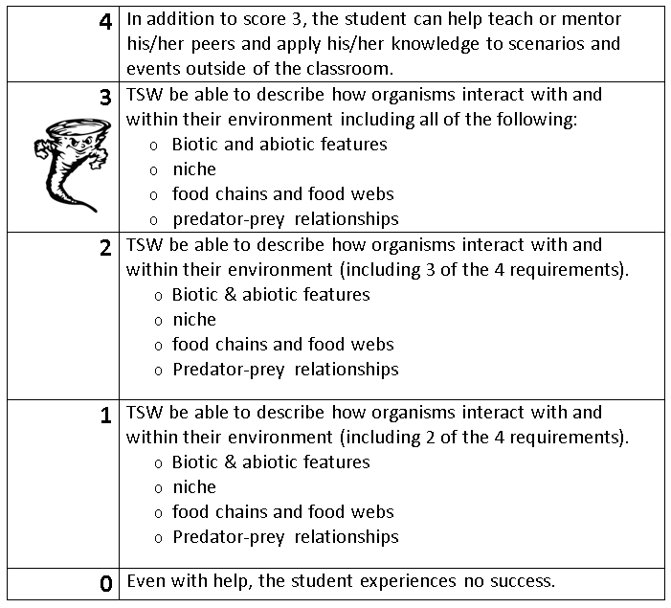
Learning Goal and Scale
TSW be able to describe how organisms interact with and within their environment (including biotic and abiotic features, niche, food chains & webs, and predator-prey relationships).

